Slide 1

Air Quality Forecasting
for multivariate time series problem
Group 3
Supervisors: Assoc. Prof. Nguyễn Thị Kim Anh
Prof. Trần Việt Trung
Students:
Tạ Hữu Bình 20190094
Trần Trọng Hiệp 20190051
Nguyễn Văn Trung 20190071
Hà Đức Tuấn 20190072

Slide 2
Contents
Problem
Data
Approaches
Conclusion

Slide 3
Contents
Problem
Data
Approaches
Conclusion

Slide 4
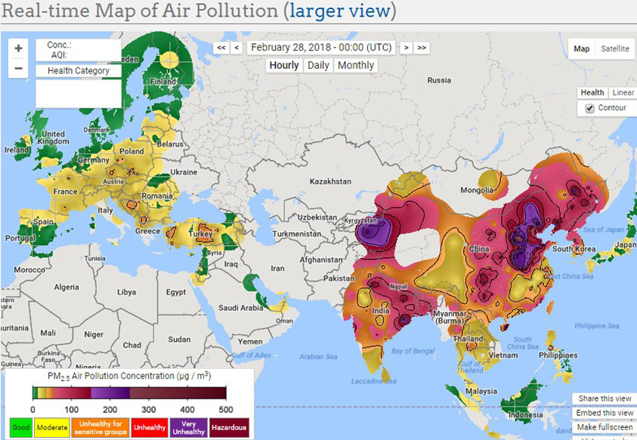
Idea
Air quality reality:
Air pollution is a global problem.
Air pollution is detrimental for health, ecosystems, damages
property, impacts visibility and haze, and threatens food and
water security.
In Delhi, an estimated
18.6 percent of total air
pollution in Delhi
comes from the
industrial sector,
several hundred tons
of pollutants released
into the atmosphere
over the course of the year from factories alone.
Notes:
http://www.careourearth.com/wp-content/uploads/2018/02/Real-time-AQI-Visual-Map_Berkeley.jpg
https://www.iqair.com/world-air-quality-ranking
https://www.weforum.org/agenda/2016/10/air-pollution-facts/
https://www.iqair.com/world-most-polluted-cities/world-air-quality-report-2021-en.pdf
https://www.careourearth.com/real-time-air-quality-index-visual-map-excellent/
https://www.orfonline.org/expert-speak/taking-on-a-burning-problem-mumbais-air-pollution/

Slide 5
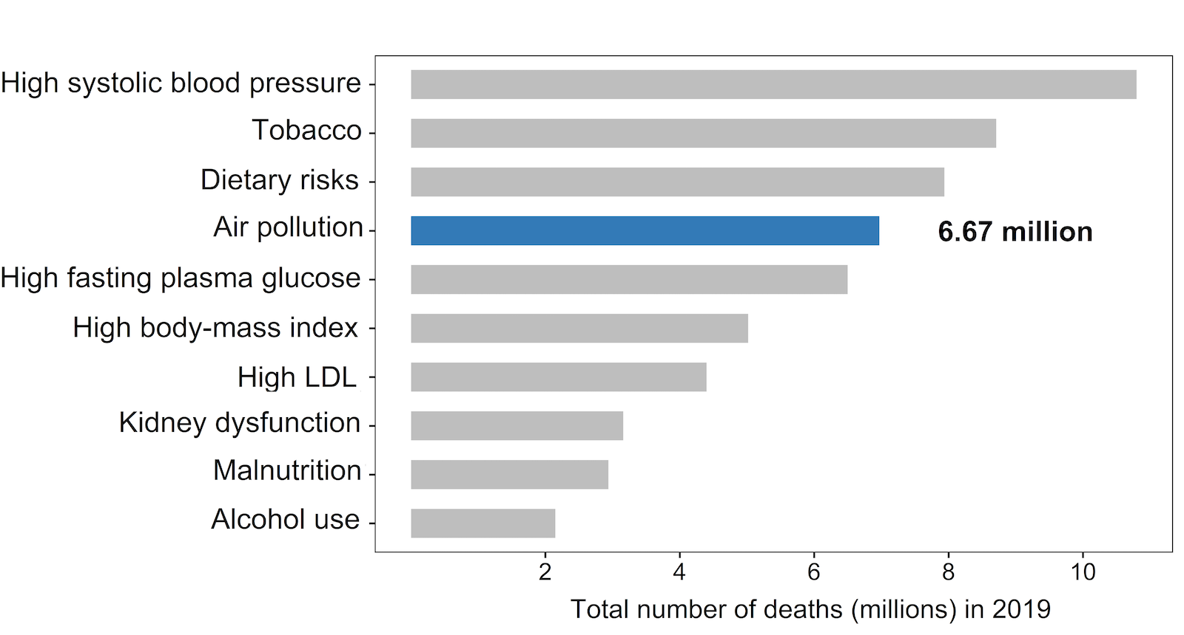
Idea
Facts about Air Pollution:
Air pollution is now considered to be the world’s largest environmental health threat, accounts for nearly seven million deaths around the world every year.
The estimated daily economic cost of air pollution has been figured at $8 billion USD, 3 to 4% of the gross world product.
Notes:
https://www.iqair.com/world-most-polluted-cities/world-air-quality-report-2021-en.pdf
https://www.weforum.org/agenda/2016/10/air-pollution-facts/
https://www.oecd.org/env/air-pollution-to-cause-6-9-million-premature-deaths-and-cost-1-gdp-by-2060.htm
https://www.stateofglobalair.org/health

Slide 6
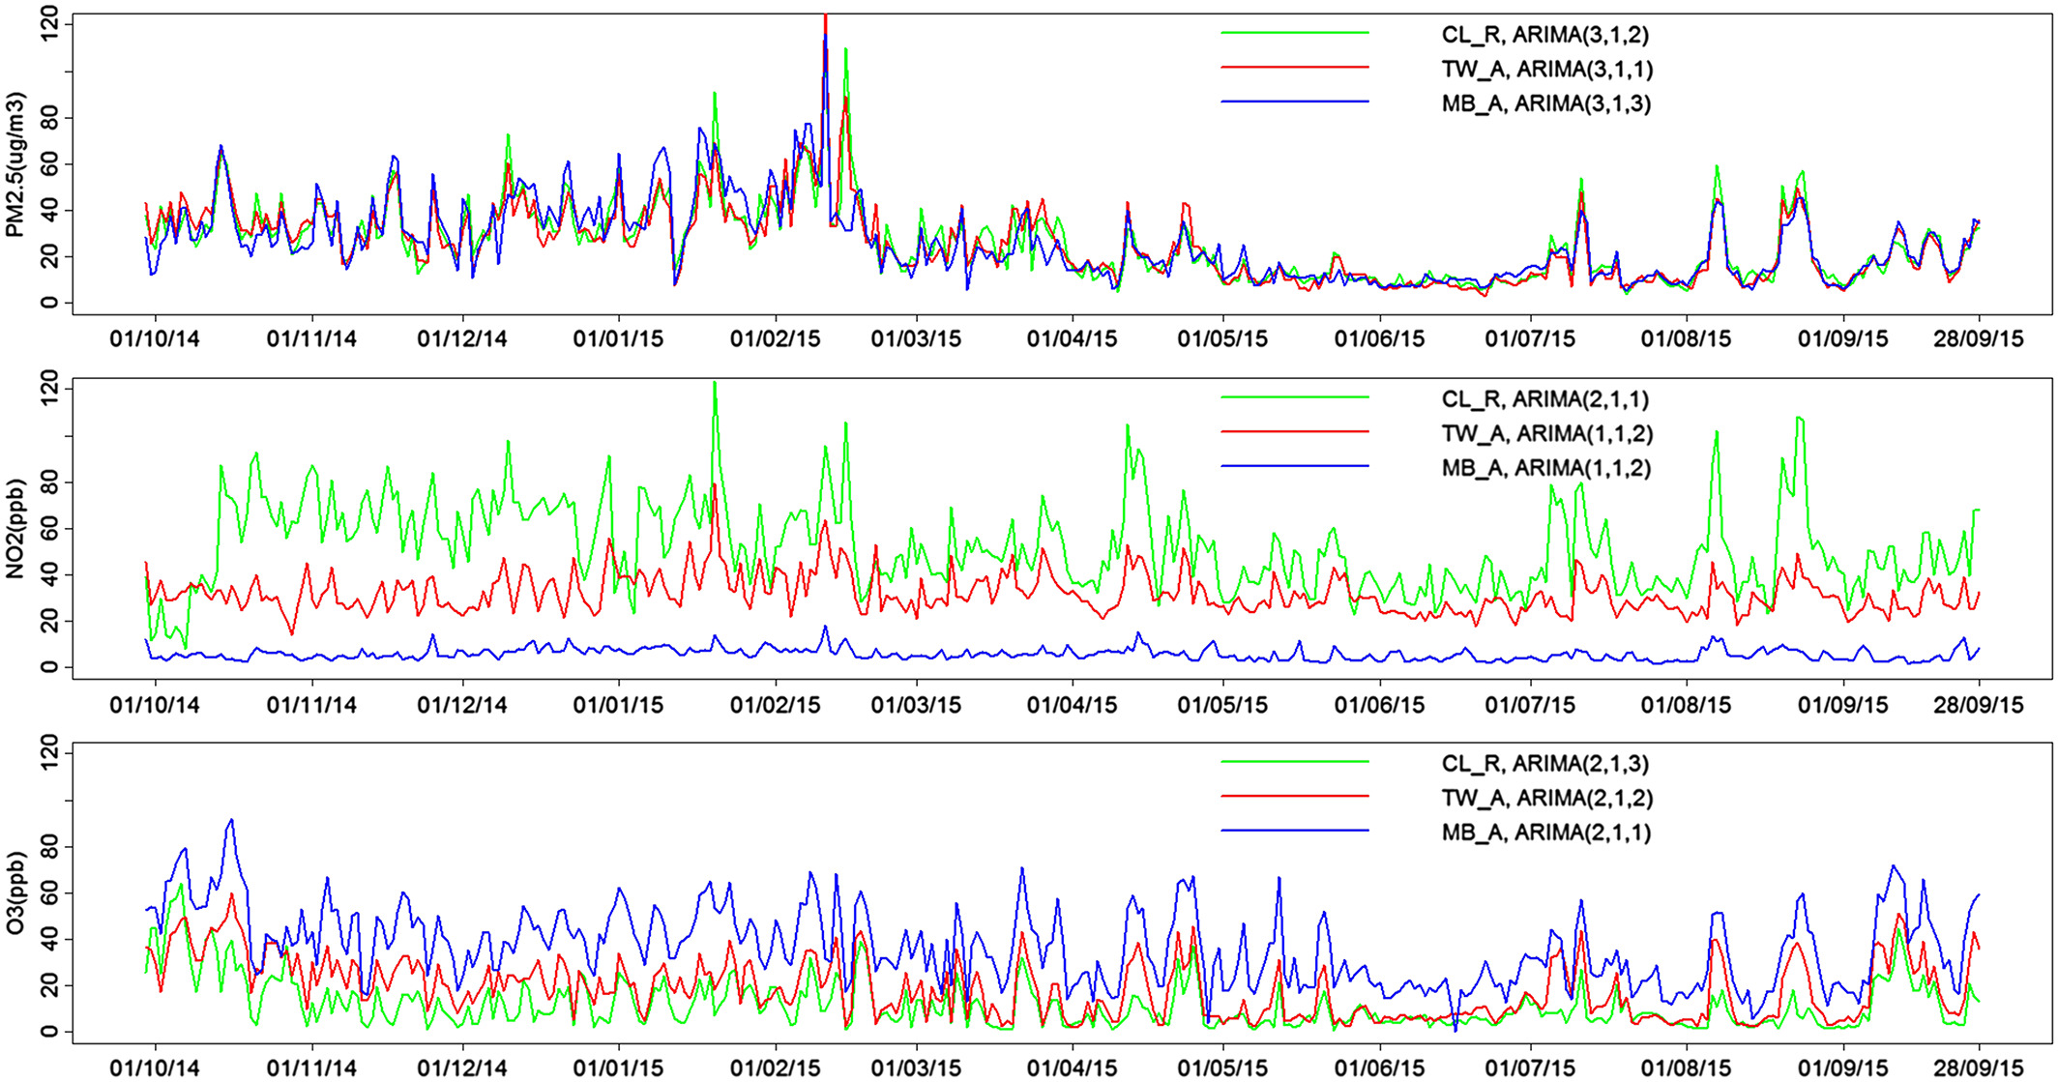
Idea
What and why forecasting air quality?
Air pollution forecasting is the application of science and technology to predict the composition of the air pollution in the atmosphere for a given location and time.
Accurate forecasting helps people plan ahead, decreasing the effects on health and the costs associated.
Notes:
https://www.iqair.com/world-most-polluted-cities/world-air-quality-report-2021-en.pdf
https://www.weforum.org/agenda/2016/10/air-pollution-facts/
https://www.oecd.org/env/air-pollution-to-cause-6-9-million-premature-deaths-and-cost-1-gdp-by-2060.htm
https://www.stateofglobalair.org/health
https://en.wikipedia.org/wiki/Air_pollution_forecasting
https://agupubs.onlinelibrary.wiley.com/doi/full/10.1002/2017JD028052

Slide 7
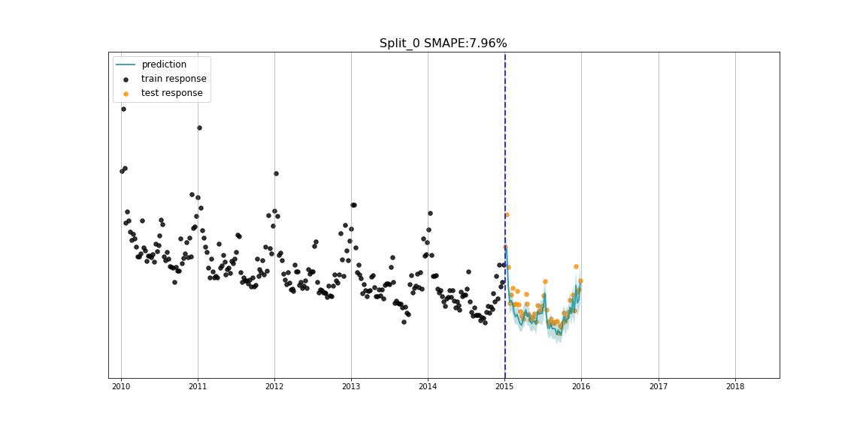
Time series forecasting problem
Time series forecasting is a set of methods in statistics and data science to predict some variables that develop and change over time.
The underlying intention of time series forecasting is determining how target variables will change in the future by observing historical data from the time perspective, defining the patterns, and yielding short or long-term
predictions on how
change occurs –
considering the
captured patterns.
Notes:
https://www.iqair.com/world-most-polluted-cities/world-air-quality-report-2021-en.pdf
https://www.weforum.org/agenda/2016/10/air-pollution-facts/
https://www.oecd.org/env/air-pollution-to-cause-6-9-million-premature-deaths-and-cost-1-gdp-by-2060.htm
https://www.stateofglobalair.org/health
https://en.wikipedia.org/wiki/Air_pollution_forecasting
https://agupubs.onlinelibrary.wiley.com/doi/full/10.1002/2017JD028052

Slide 8
Contents
Problem
Data
Approaches
Conclusion

Slide 9
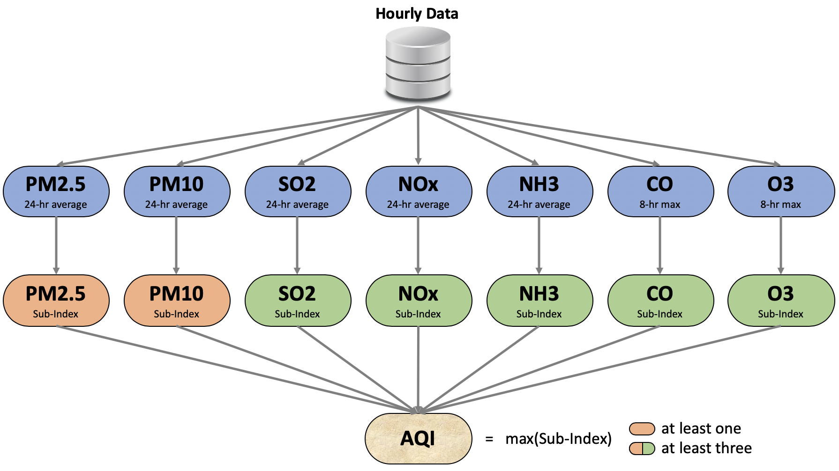
Data
Source: https://www.kaggle.com/datasets/rohanrao/air-quality-data-in-india.
Data contains air quality information of 26 cities in India from 2015 to 2020 by each hour.
Delhi had the most observations (48192) and the highest number of NaN in one column (ignoring Xylene) is 2421 samples, 5.02% of total.
Notes:
https://www.iqair.com/world-most-polluted-cities/world-air-quality-report-2021-en.pdf
https://www.weforum.org/agenda/2016/10/air-pollution-facts/
https://www.oecd.org/env/air-pollution-to-cause-6-9-million-premature-deaths-and-cost-1-gdp-by-2060.htm
https://www.stateofglobalair.org/health
https://en.wikipedia.org/wiki/Air_pollution_forecasting
https://agupubs.onlinelibrary.wiley.com/doi/full/10.1002/2017JD028052

Slide 10
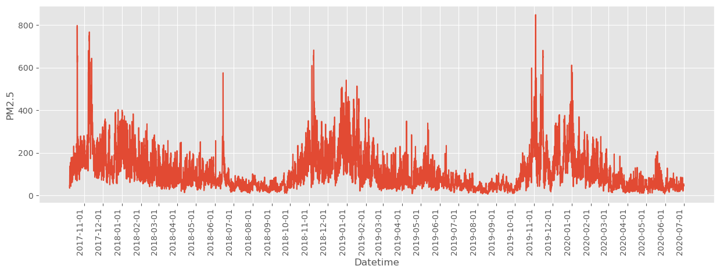
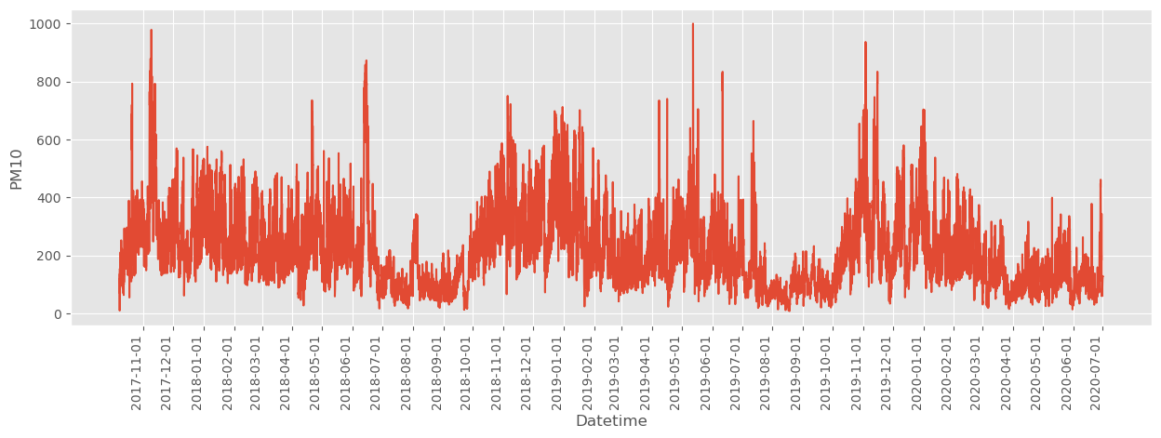
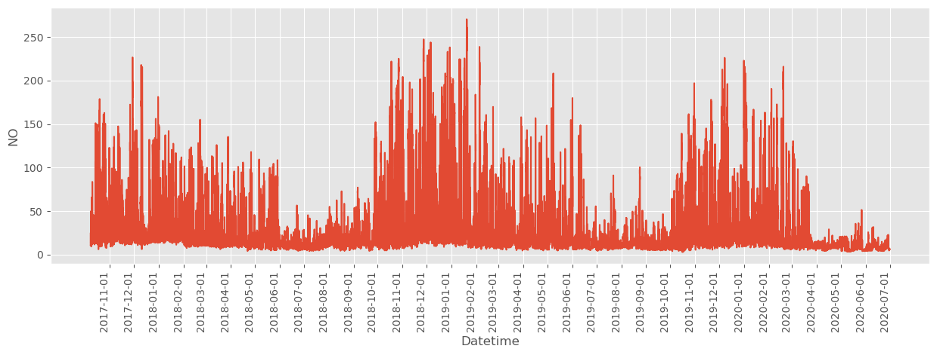
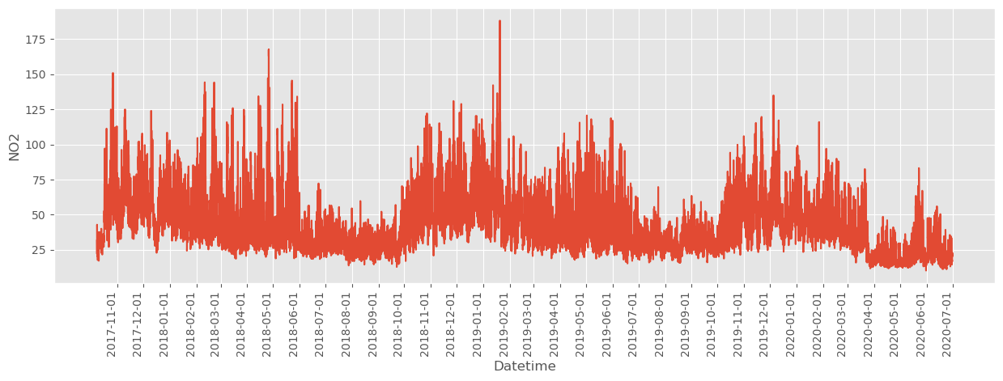
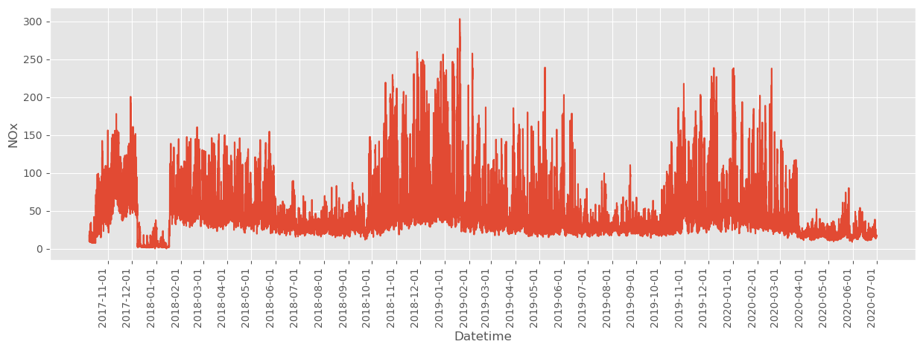
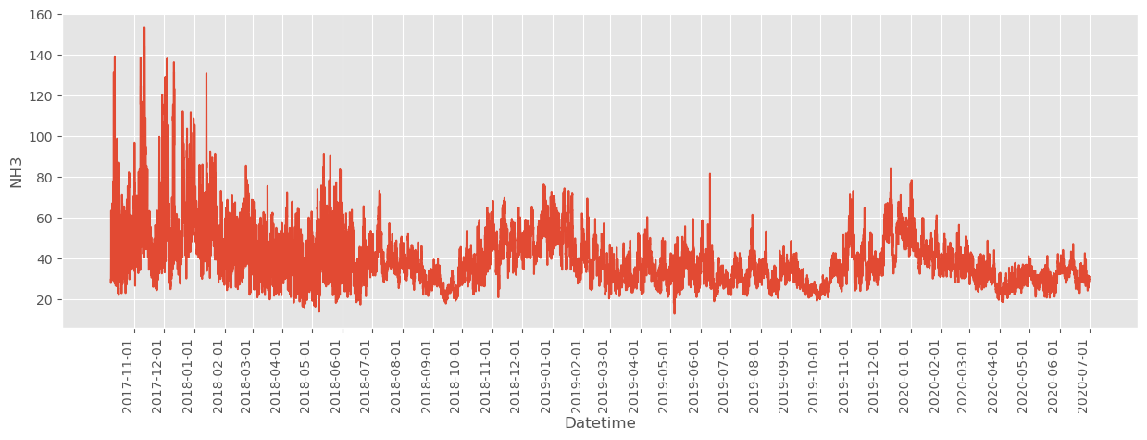
Data
Notes:
https://www.iqair.com/world-most-polluted-cities/world-air-quality-report-2021-en.pdf
https://www.weforum.org/agenda/2016/10/air-pollution-facts/
https://www.oecd.org/env/air-pollution-to-cause-6-9-million-premature-deaths-and-cost-1-gdp-by-2060.htm
https://www.stateofglobalair.org/health
https://en.wikipedia.org/wiki/Air_pollution_forecasting
https://agupubs.onlinelibrary.wiley.com/doi/full/10.1002/2017JD028052

Slide 11
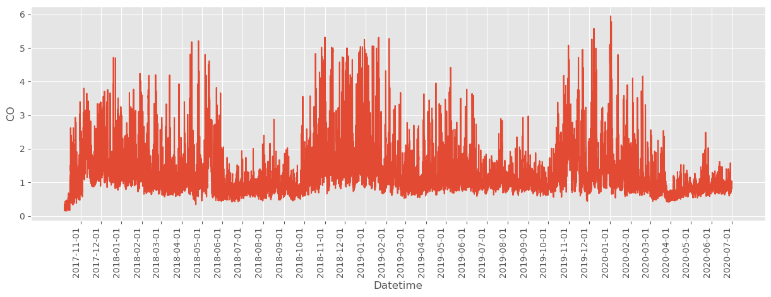
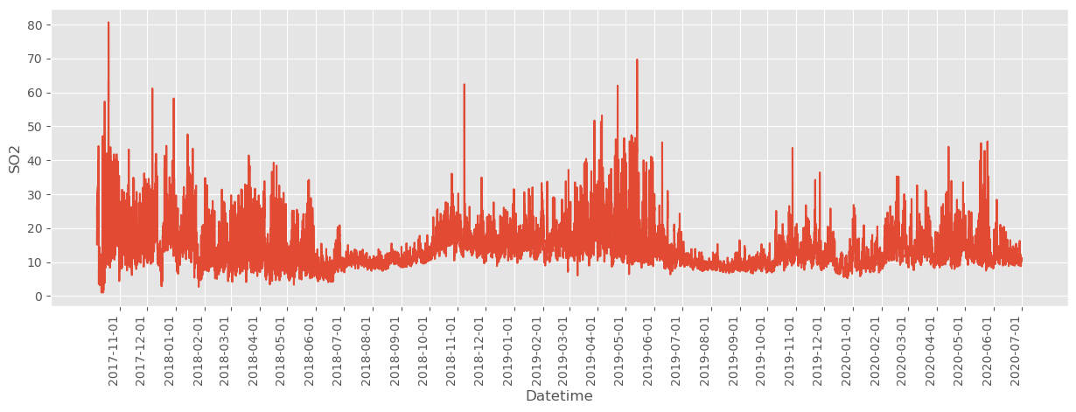
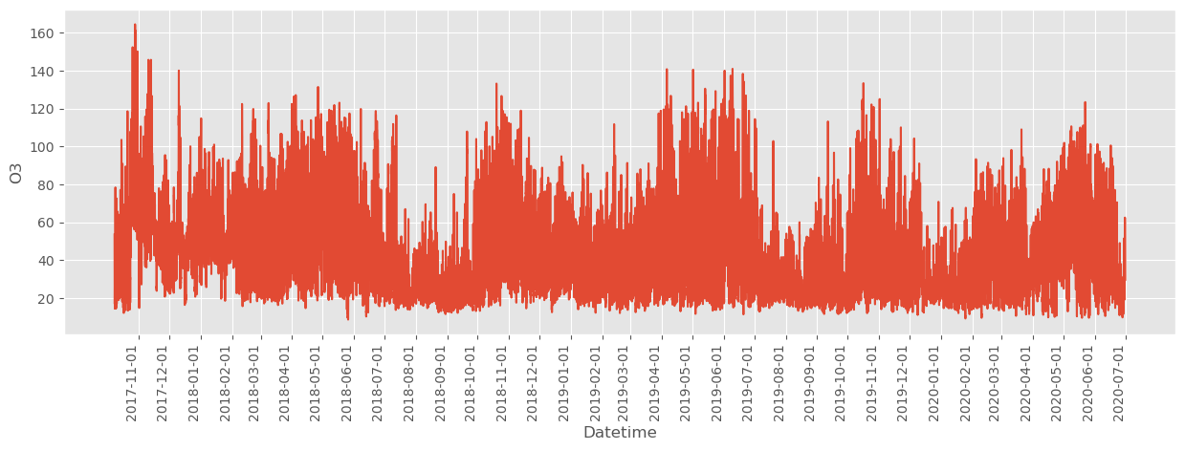
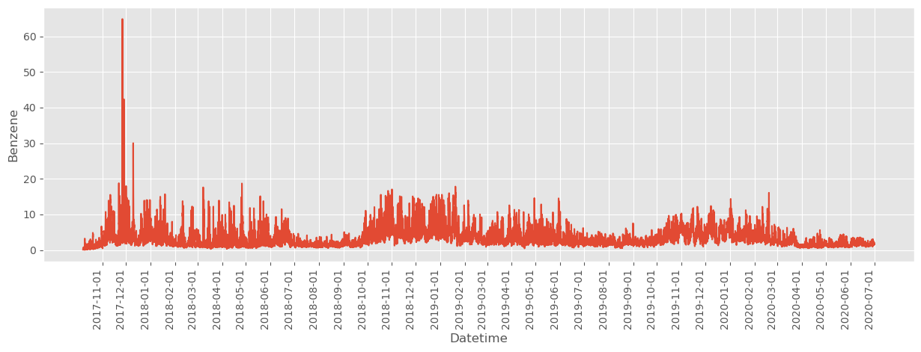
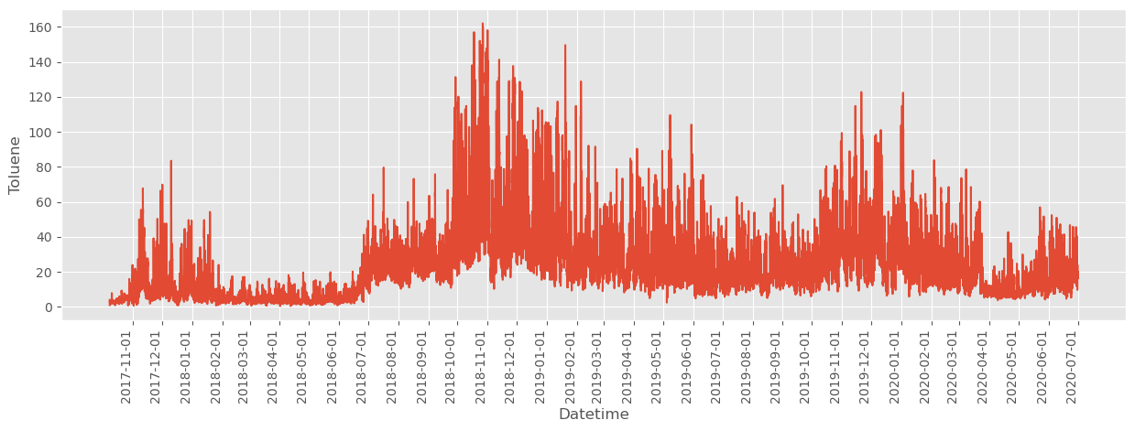
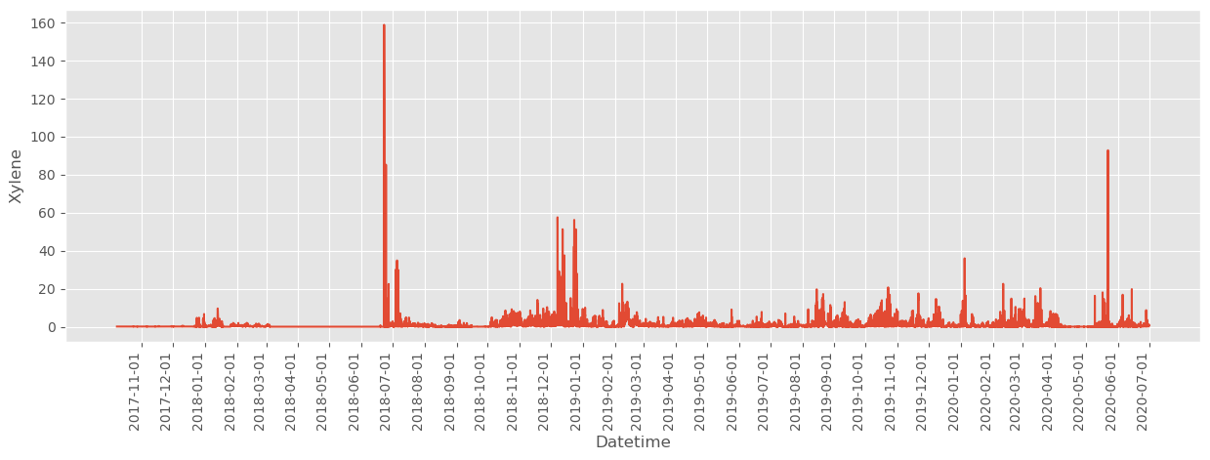
Data
Notes:
https://www.iqair.com/world-most-polluted-cities/world-air-quality-report-2021-en.pdf
https://www.weforum.org/agenda/2016/10/air-pollution-facts/
https://www.oecd.org/env/air-pollution-to-cause-6-9-million-premature-deaths-and-cost-1-gdp-by-2060.htm
https://www.stateofglobalair.org/health
https://en.wikipedia.org/wiki/Air_pollution_forecasting
https://agupubs.onlinelibrary.wiley.com/doi/full/10.1002/2017JD028052

Slide 12
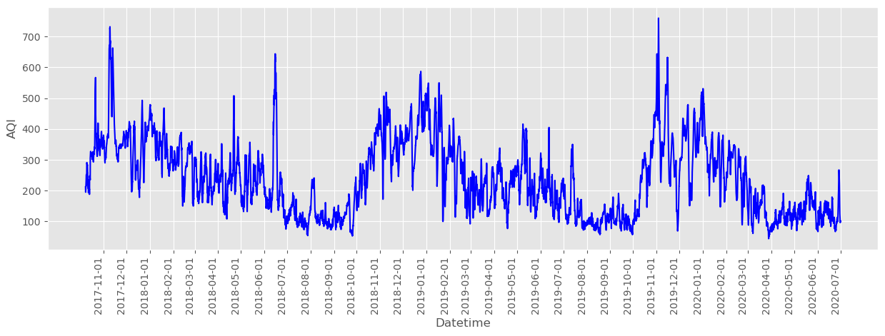
Data
Notes:
https://www.iqair.com/world-most-polluted-cities/world-air-quality-report-2021-en.pdf
https://www.weforum.org/agenda/2016/10/air-pollution-facts/
https://www.oecd.org/env/air-pollution-to-cause-6-9-million-premature-deaths-and-cost-1-gdp-by-2060.htm
https://www.stateofglobalair.org/health
https://en.wikipedia.org/wiki/Air_pollution_forecasting
https://agupubs.onlinelibrary.wiley.com/doi/full/10.1002/2017JD028052

Slide 13
Contents
Problem
Data
Approaches
Conclusion

Slide 14
Data
De Saa, Eranga, and Lochandaka Ranathunga. "Comparison between ARIMA and Deep Learning Models for Temperature Forecasting." arXiv preprint arXiv:2011.04452 (2020).
→ MSE: Deep Learning (1.9006) vs ARIMA (2.4214) in hourly temperature.
Siami-Namini, Sima, Neda Tavakoli, and Akbar Siami Namin. "A comparison of ARIMA and LSTM in forecasting time series." 2018 17th IEEE international conference on machine learning and applications (ICMLA). IEEE, 2018..
The average reduction in error rates obtained by LSTM was between 84 – 87 percent compared to ARIMA using historical monthly financial from 1985 to 2018 from Yahoo finance Website.
Menculini, Lorenzo, et al. "Comparing prophet and deep learning to ARIMA in forecasting wholesale food prices." Forecasting 3.3 (2021): 644-662.
→ RMSE: CNN + LSTM (0.2) > ARIMA (0.211) > Prophet (0.35) using dataset of food order.
Notes:
https://www.iqair.com/world-most-polluted-cities/world-air-quality-report-2021-en.pdf
https://www.weforum.org/agenda/2016/10/air-pollution-facts/
https://www.oecd.org/env/air-pollution-to-cause-6-9-million-premature-deaths-and-cost-1-gdp-by-2060.htm
https://www.stateofglobalair.org/health
https://en.wikipedia.org/wiki/Air_pollution_forecasting
https://agupubs.onlinelibrary.wiley.com/doi/full/10.1002/2017JD028052

Slide 15
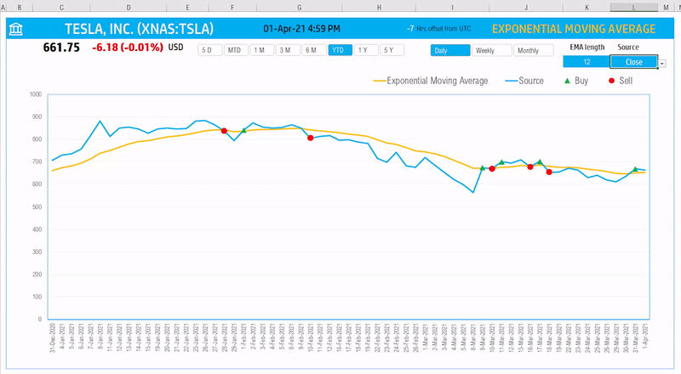
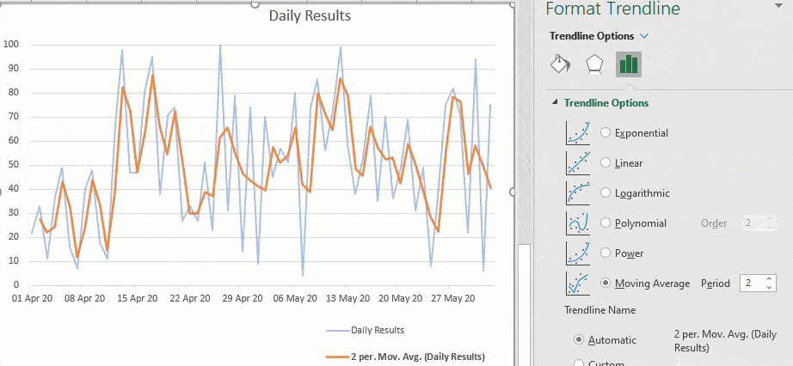
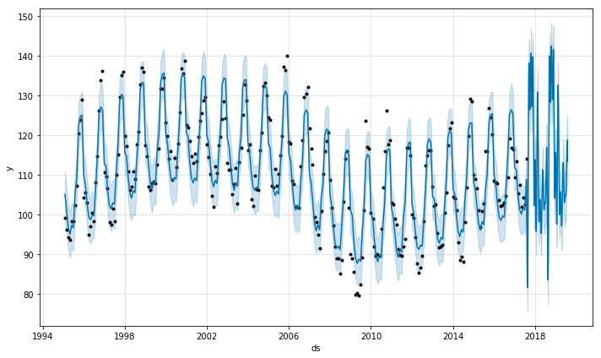
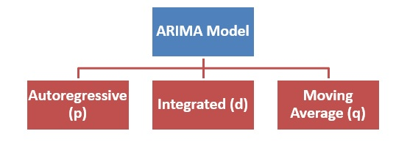
Models
Autoregressive integrated moving average (ARIMA)
Vector Autoregressive Moving Average (VARMA)
Facebook Prophet

Slide 16
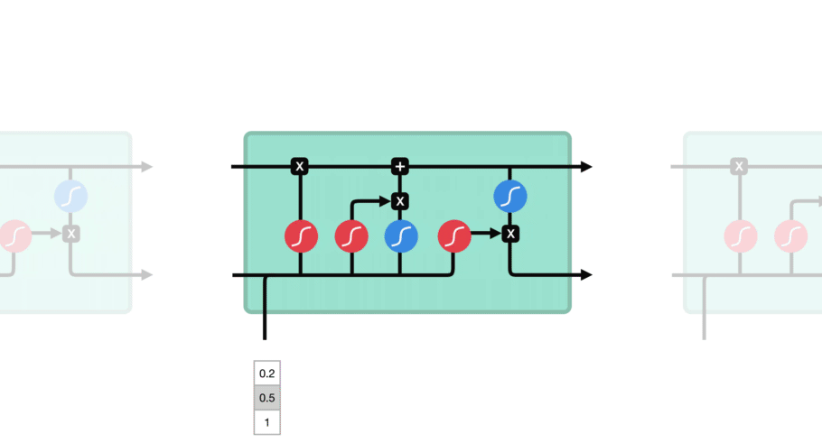
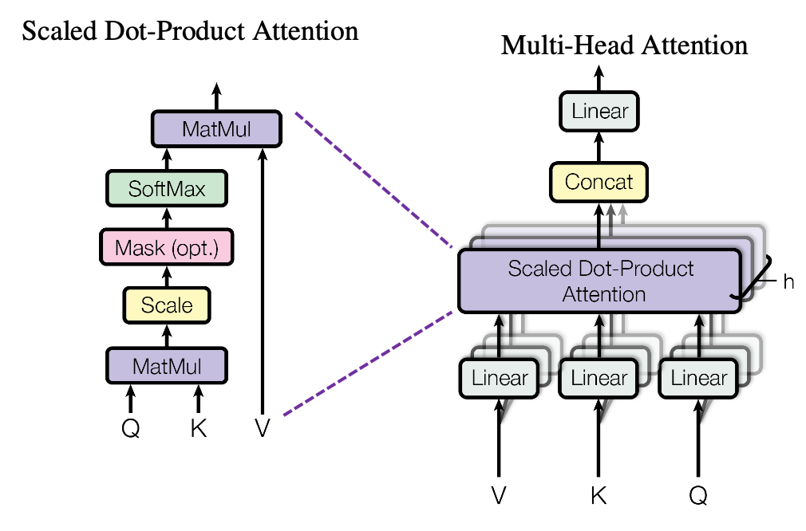
Models
Autoregressive integrated moving average (ARIMA)
Vector Autoregressive Moving Average (VARMA)
Facebook Prophet
Long Short Term Memory Network (LSTM)
Multi-Head Attention

Slide 17
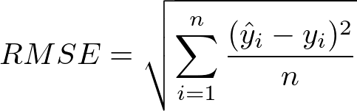
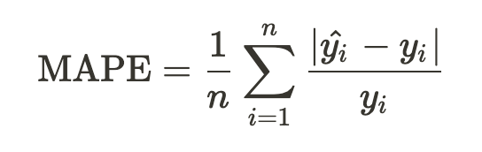
Experiments
Training, validation, and test set taken from Air Quality Data in Delhi (2015 - 2020).
Metrics:
RMSE: Root Mean Square Error
MAPE: Mean Absolute Percentage Error
Test scenarios:
Impact of hyper-parameters in each model
Performance of each model

Slide 18
Contents
Problem
Data
Approaches
Conclusion

Slide 19
Conclusion
Present the problem.
Data to use
Proposal:
Moving average
LSTM + Attention mechanism
Experiments:
RMSE and MAPE as error metrics.
Observe the impact of hyper-parameters
Comparing performance of proposed models

Slide 20
THANK YOU !

